Slide 1



Slide 2


Bringing your expetertise to the market
Welcome and expectations
What is the problem you are trying to solve, or the market niche your are targeting?
Identifying needs: who, what, when, where, why?
Mapping actions: how can you translate your expertise into a product or service?
Conclusion and check out

Slide 3
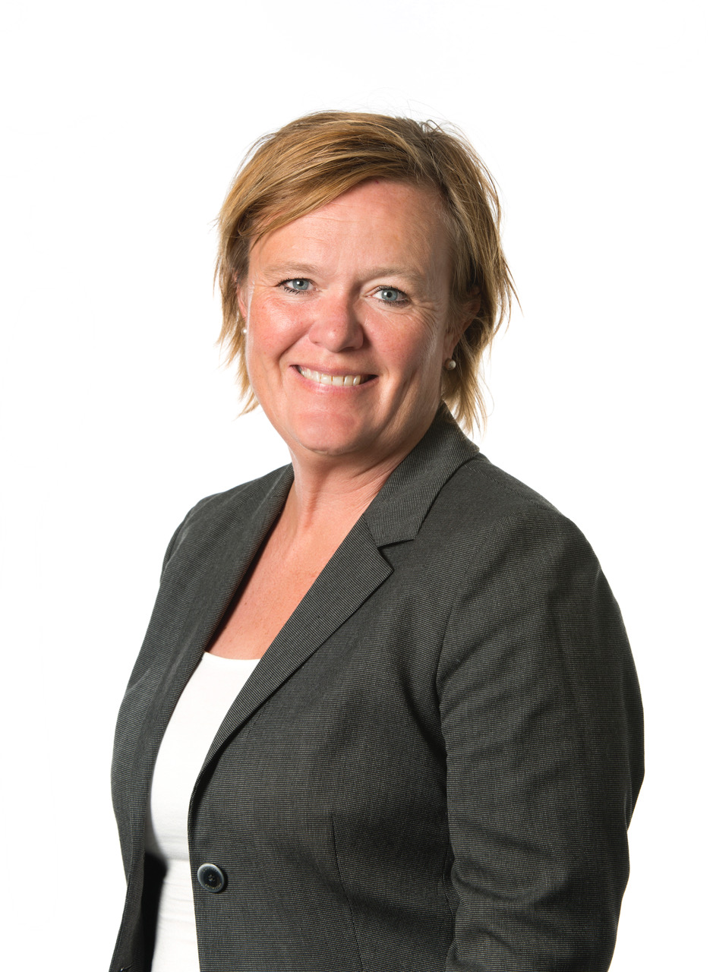

Charlotta Nordenberg
LCharlotta
ipsm dolor
Bachelor in Social Sciences
University work:
Internationalisation, Research funding, Fundraising, Innovation and utalisation, projectmanager, advisor, head of unit
NGO and other associations:
Chairperson of Student Union at Örebro University, Chairperson of Amnesty International in Sweden, Chairperson of KIF Örebro, Boardmember of Elitfotbolldam (Swedish football association for women) and member of the nomination committee at the Swedish Golf association
Network, socially engaged, want to make change, ….

Slide 4

Malmö University in numbers
Founded in 1998
24,000 students
2,143 employees
90 professors
430 doctoral-level teachers
271 PhD students (62% female)
100 degree programmes and 350 courses
500 international peer-reviewed articles
1.76 billion SEK turnover (2019)

Slide 5

The city of Malmö
Sweden’s third largest city with a population of 330,000
previously a traditional industrial city, now a metropolis of knowledge, culture and entrepreneurship
linked with Copenhagen via the Öresund Bridge, Malmö is in the heart of the Öresund region (population of 4 million)
culturally diverse city with 170 nationalities represented and more than 150 languages spoken
32% of the population have at least three years of higher education
half of the population are under the age of 35
Notes:
“culturally diverse city with 170 nationalities represented and more than 150 languages spoken”: Malmö Stad (https://malmo.se/Nice-to-know-about-Malmo/The-story-of-Malmo/The-young-and-global-city-.html)
“32 per cent of the population have at least 3 years of higher education”: SCB, 2016. Utbildningsnivå efter kommun och kön. https://www.scb.se/uf0506/

Slide 6

The city of Malmö
Innovative
Malmö has been ranked by Forbes as the fourth most innovative city in the world. Seven start-up companies are launched every day in Malmö.
Sustainable
Malmö is at the forefront of sustainability, internationally renowned for its urban development projects.
Happy
In 2016, Malmö was voted the seventh happiest place to live in Europe by the European Commission.
Bicycle friendly
Nominated as the sixth most bicycle friendly city in the world, the city allows for easy, safe and environmentally-friendly travel.

Slide 7
Expectations

Slide 8
Innovation
OECD (2018) defines innovation as new improved products and/or processes.
Products include both goods and services, and processes include processes for manufacturing and the delivery and production of products.
Most importantly, innovation is the actual value that is created by new products, services and methods rather than the products, services and methods themselves.

Slide 9
FEA- project for students innovation and entrepreneurship
MaU Holding
Drivhuset
Innovation
Advisors
MaU
Innovation
Legal
advisors
Project
Managers
Innovation Office
Storm
Innovation Hub
Grants
Office
Communication
support

Slide 10
What is the problem you are trying to solve,
or the market niche your are targeting?

Slide 11
Key Processes- Process
Enablers
Start up
Investigate
Explore
Develop
Licensing
Collaboration
Start meeting
Idea is possible to develop for a market/society
- not only research
Commercial/utalisation potential
IP potential
Homework
for researcher
NABC
SWOT
Verification
IP
Agreements
Market evaluation
Technical validation
Regulations and requirements
Team building
Lean Canvas
Value creation
Pitch training
Match making
Partnering
Financing
Agreement/Legal
Value Creation Forum
Coaching/Advice
Business
IP protection
Packetizing
Innovation Office
Holding company
Incubator programs, mentor program
Reference, modified from UU Innovation

Slide 12
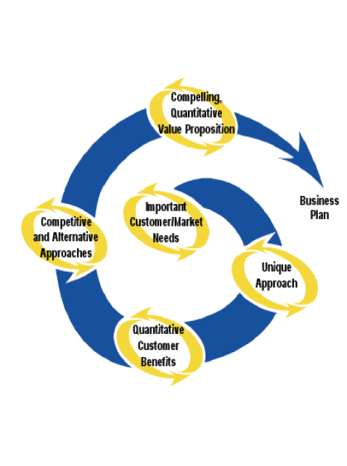
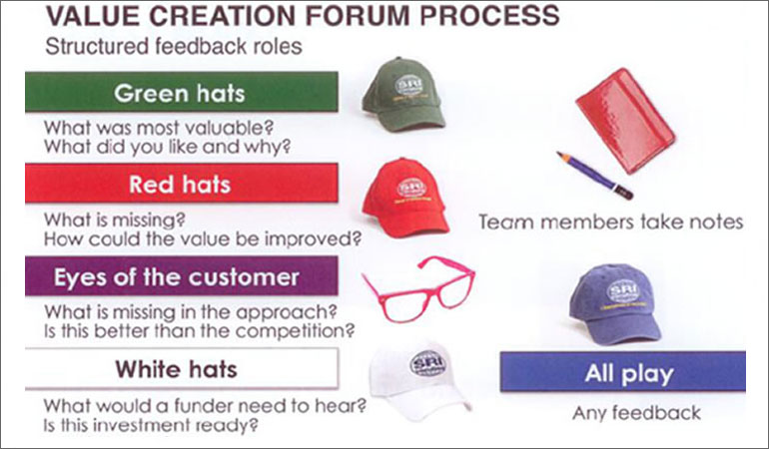
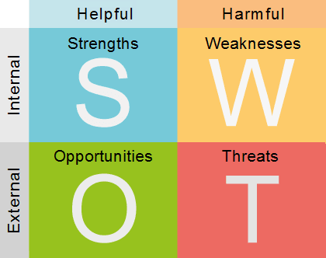
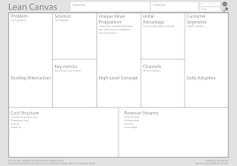
Key Processes- ex. Methods
Enablers
NABC | SWOT | LEAN CANVAS | Value Creation Forum
Stanford Research Institute N for Need. Most important factor! A for Approach. Proposition. B for Benefit. The innovative elements of an idea, its uniqueness. C for Competition. Competition existing in the area concerned. |  | Alexander Osterwalder, The Business Model Canvas, 2008 , adapted to Lean Canvas | Stanford Research Institute
Litt: Innovation: The Five Disciplines for Creating What Customers Want,
Curtis R. Carlson & William W. Wilmot
SRI International (www.sri.com)

Slide 13
Utilisation and value creation of your research
Who is your research for?
Are your aware of, or have identified any potential innovation in your research today?
Who could use your research result?
What impact could your research have?
In what area in the society could your research contribute?

Slide 14
https://imp-act.se/verktyg-iam-processens-olika-steg-med-resurser/

Slide 15
IAM (Inventory Assets Management ) tool
Identify assets
Review of knowledge assets
Analysis
Plan for utliization
Prepare the work
IA capture work shop
Identify the ownership
Assets as IPR
Mapping of resourcs and assets
Extern analysis
Discussion of alternative
Decision on management of IA
Next step
Goal and
challenges
https://imp-act.se/verktyg-iam-processens-olika-steg-med-resurser/

Slide 16
Examples of Valuable links för impact planning tools
Impact Planning Toolkit ( The University of Sheffield)
https://www.sheffield.ac.uk/rs/impact/planning_toolkit
Impact planning Canvas (University College Dublin)
https://www.ucd.ie/research/portal/outcomesandimpacts/impactplancapturecommunicate/
”Research impact is the contribution that research makes to the economy, society,
environment or culture, beyond the contribution to academic research”

Slide 17

Break
15 minutes

Slide 18
Identifying needs: who, what, when, where, why?
Mapping actions: how can you translate your expertise into a product or service?

Slide 19
The value proposition- the pitch
Hook Get peoples attention
Need IMPORTANT user needs!
Approach What is your offer?
Benefits What benefits does your offer create?
Competition What the alternetives are?
Offer What you offer/want

Slide 20
NABC not NABC

Slide 21
10 minutes to use NABC
Reflection

Slide 22
The power of iterations
V
a
l
u
e
P
r
o
P
Q
u
a
l
i
t
y
This works!
It might work
Will this work
This won’t work
________________________________________________________
Number of iterations

Slide 23
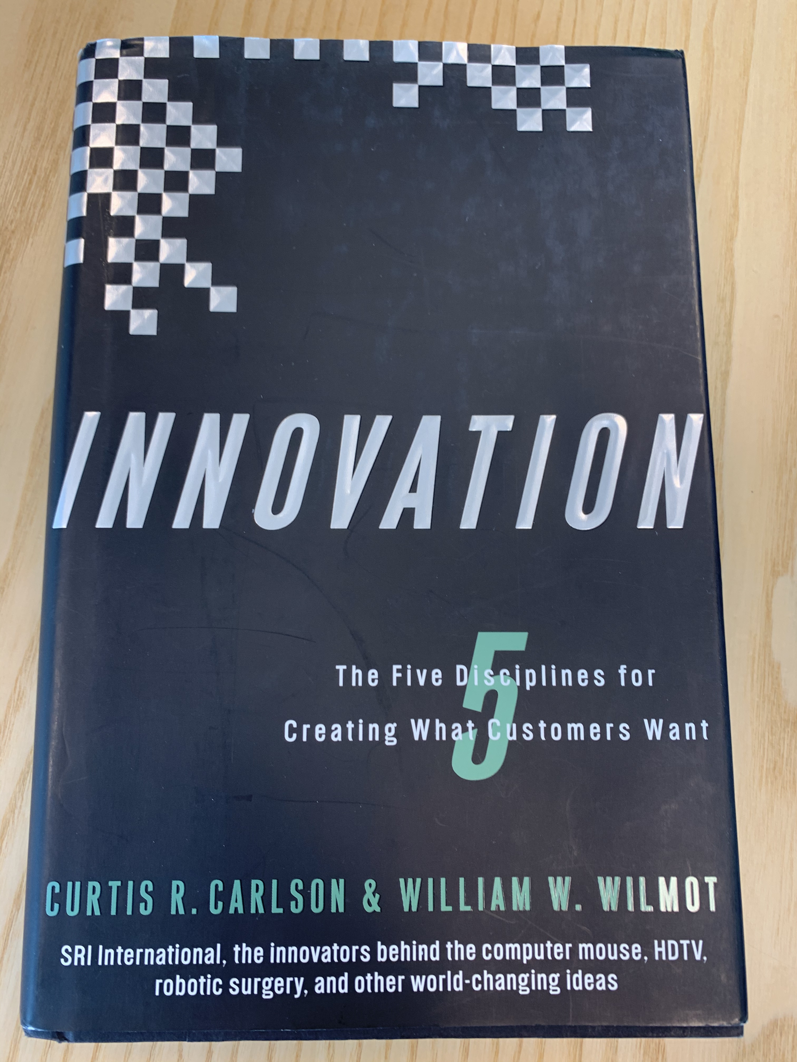
Five disciplines of innovation
Important Customer and Market Needs
Value Creation
Innovation Champions
Innovation Teams
Organizational Alignment
Innovation- The five disciplines for creating what customers want ( Curtis R Carlsson &William W.Wilmot)

Slide 24
What expertise do you need? What skills do you need ? What else do you need?
Idea
Networks
Team
Trust
Tools and methods
”Market”
Intelletcual assets
IPR (Intellectual Property Rights)
Personal and professional goals
Get to know your founders ( relations)
.........

Slide 25
Check out!

Slide 26

Feel free to contact me!
Charlotta Nordenberg
Malmö University
Manager at Mau Innovation
Charlotta.nordenberg@mau.se
+46-40- 6658202

Slide 27


